Slide 1
IGHT DYNAMICS
FL
YING FOX
077BAS005 BIBEK YONZAN
077BAS023 MANISH TAJPURIYA
077BAS042 SIMONKRITH LAMICHHANE
077BAS043 SIMRAN PAUDEL

Slide 2
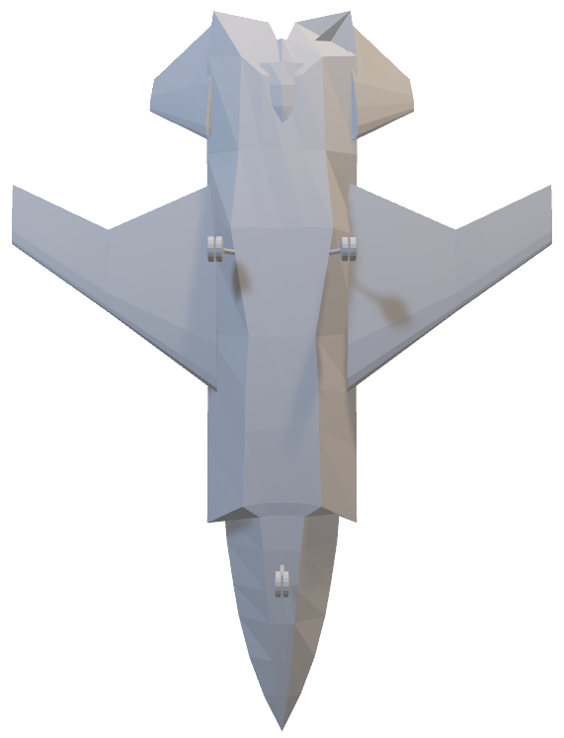
Unmanned
Multirole
High speed
High maneuverabilty
FL
YING FOX
Combat Aerial Vehicle

Slide 3
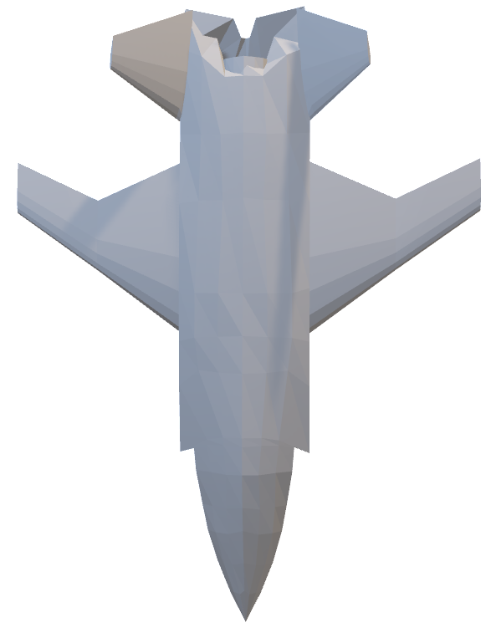
YING FOX
FL
Unmanned
Multirole
High speed
High maneuverability
Combat Aerial Vehicle
Surveillance
Reconnaissance
Wingman

Slide 4
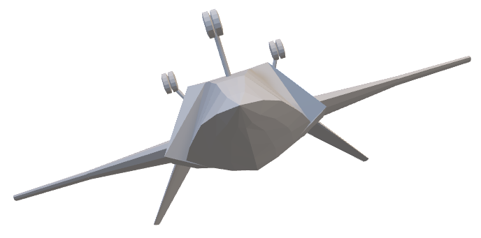
YING FOX MISSION PROFILE
YING FOX
FL
Unmanned
Multirole
High speed
High maneuverability
Combat Aerial Vehicle
Surveillance
Reconnaissance
Wingman

Slide 5
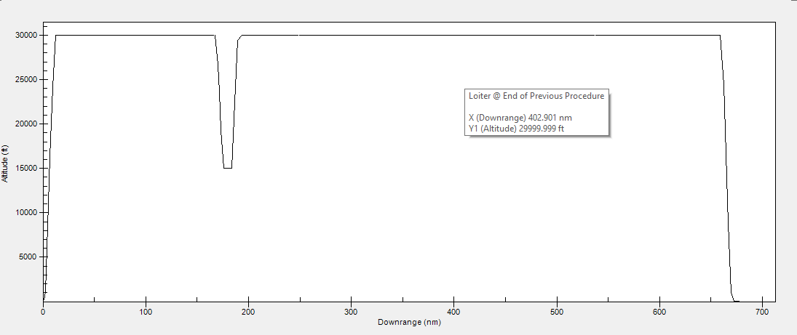

YING FOX
FL
MISSION PROFILE
Unmanned
Multirole
High speed
Takeoff & Climb
High maneuverability
Combat Aerial Vehicle
Surveillance
Reconnaissance
Wingman

Slide 6

YING FOX
FL
MISSION PROFILE
Unmanned
Multirole
Cruise
High speed
Takeoff & Climb
High maneuverabilty
Combat Aerial Vehicle
Surveillance
Reconnaisance
Wingman

Slide 7
YING FOX
FL
MISSION PROFILE
Unmanned
Multirole
Cruise
High speed
High maneuverabilty
Combat
Takeoff & Climb
Combat Aerial Vehicle
Surveillance
Reconnaisance
Wingman

Slide 8
YING FOX
FL
MISSION PROFILE
Unmanned
Multirole
Cruise
Cruise & Loiter
High speed
High maneuverabilty
Combat
Takeoff & Climb
Combat Aerial Vehicle
Surveillance
Reconnaisance
Wingman

Slide 9
YING FOX
FL
MISSION PROFILE
Unmanned
Multirole
Cruise
Cruise & Loiter
High speed
High maneuverabilty
Combat
Takeoff & Climb
Combat Aerial Vehicle
Descent & Land
Surveillance
Reconnaisance
Wingman

Slide 10
YING FOX
FL
MISSION PROFILE
Unmanned
Multirole
Cruise
Cruise & Loiter
High speed
High maneuverabilty
Combat
Takeoff & Climb
Combat Aerial Vehicle
Descent & Land
Surveillance
Reconnaisance
Wingman

Slide 11
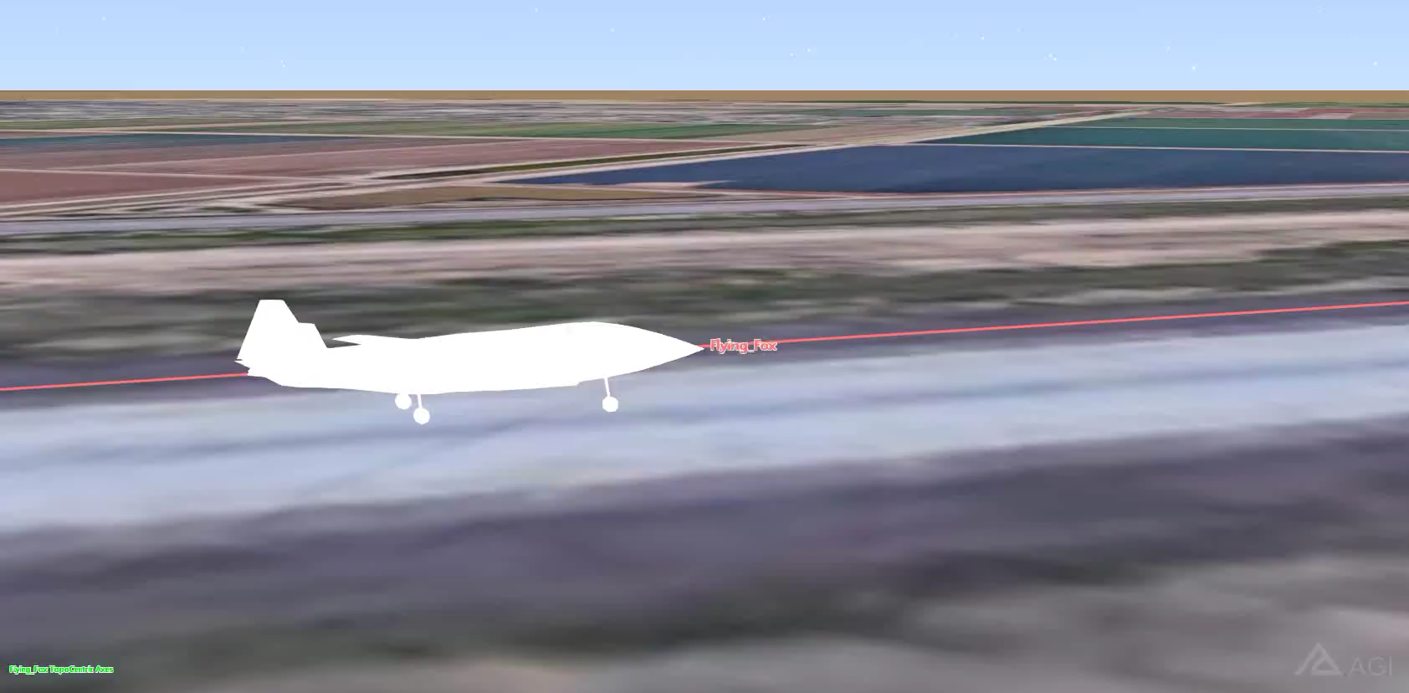
YING FOX
FL
MISSION PROFILE
Unmanned
Multirole
Cruise
Cruise & Loiter
High speed
High maneuverabilty
Combat
Takeoff & Climb
Combat Aerial Vehicle
Descent & Land
Surveillance
Reconnaisance
Wingman

Slide 12
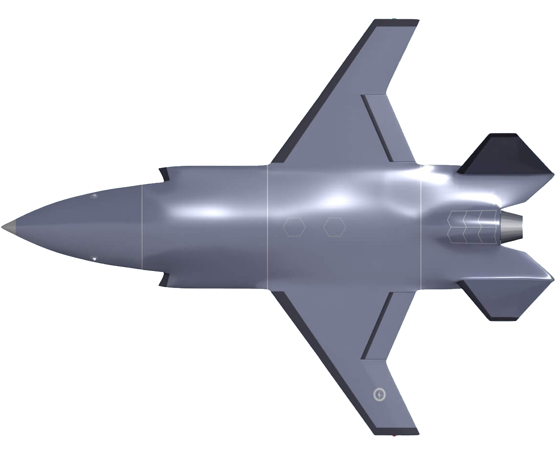
PLANEMAKER

Slide 13
PLANEMAKER

Slide 14
PLANEMAKER

Slide 15
PLANEMAKER

Slide 16
PLANEMAKER

Slide 17
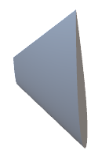
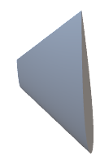

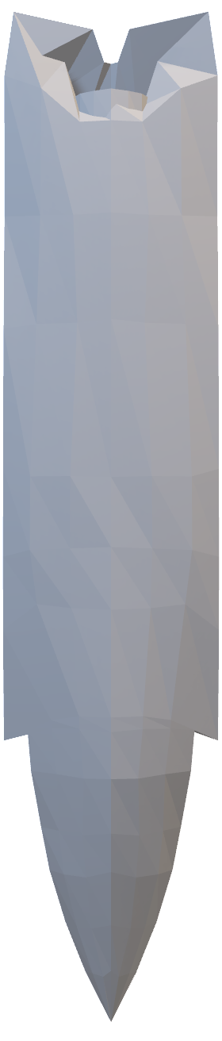

PLANEMAKER

Slide 18
PLANEMAKER

Slide 19
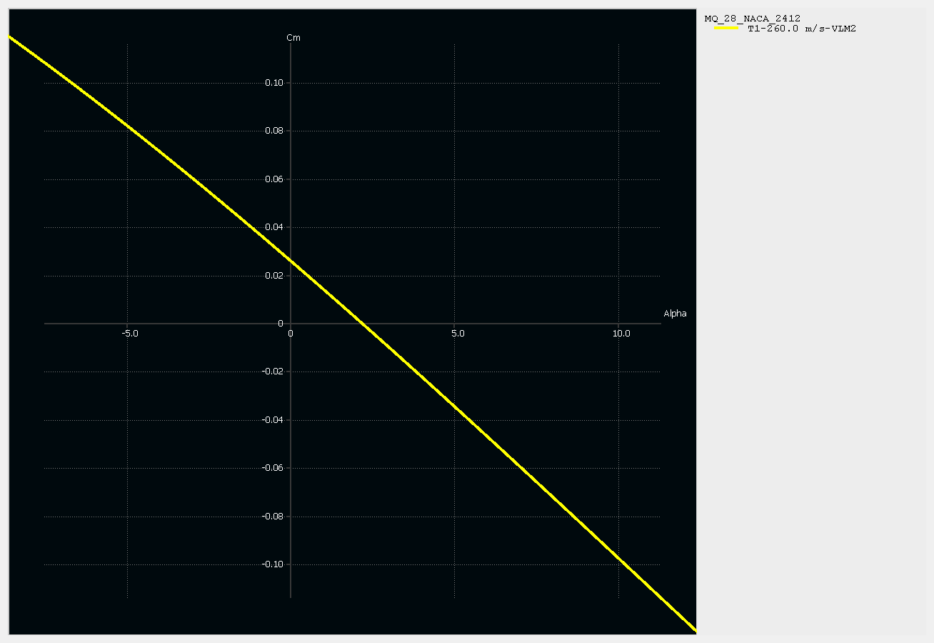
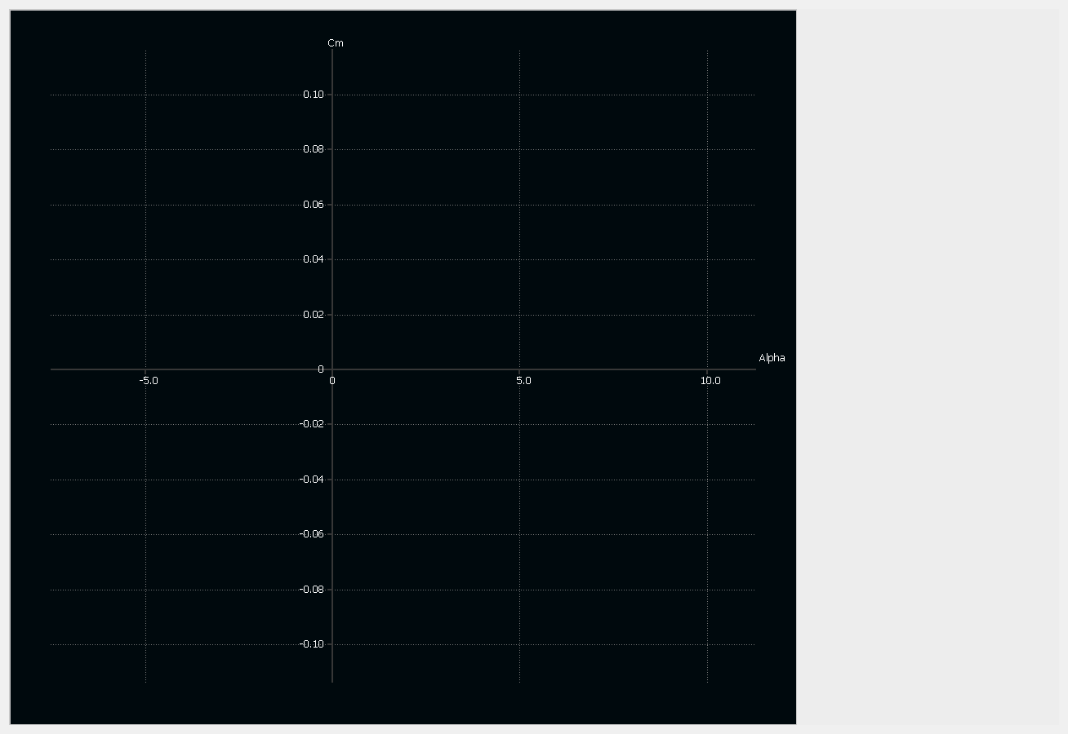
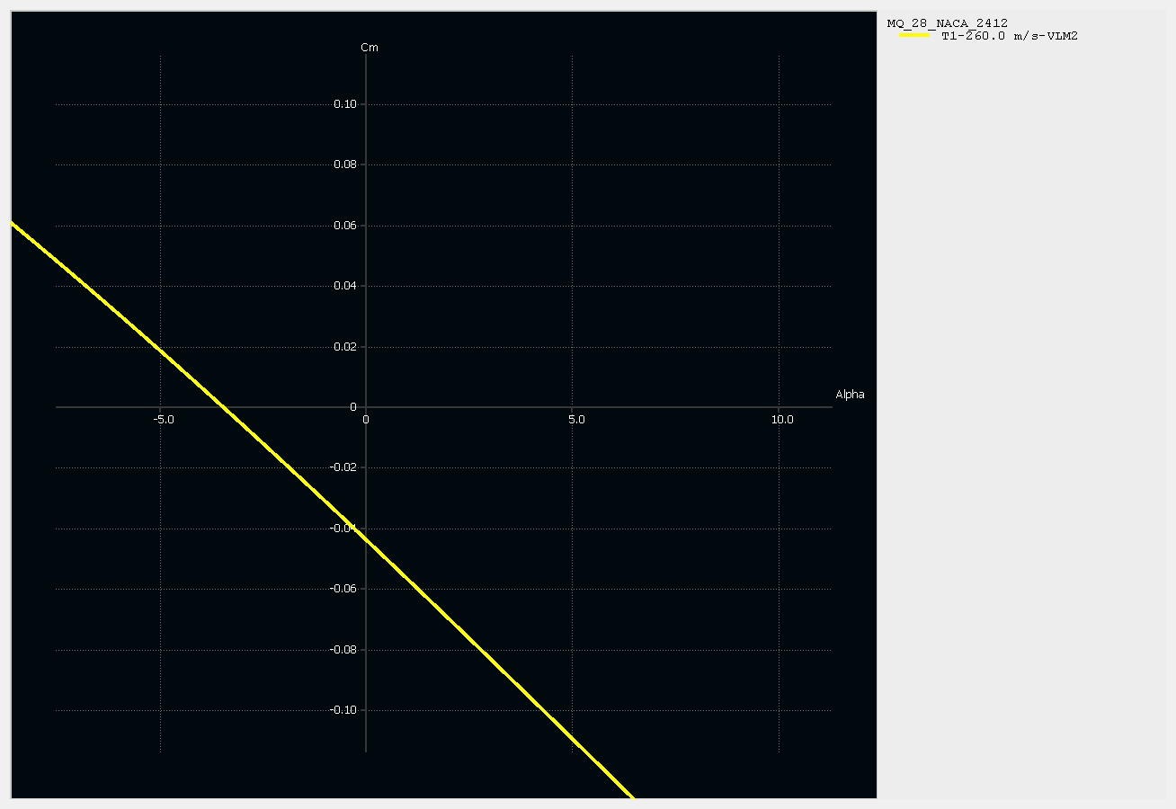
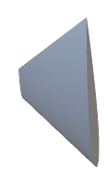


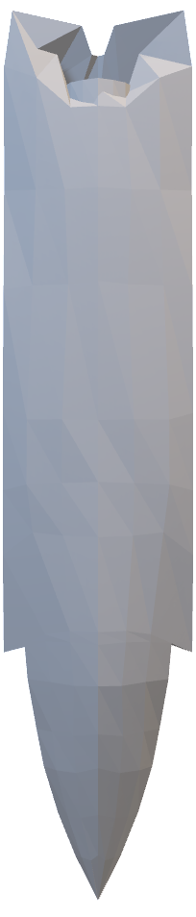
XFLR5 ANALYSIS
stable
Un
Tail Configuration
Graph Cm vs ⍺
[Un
stable]

Slide 20
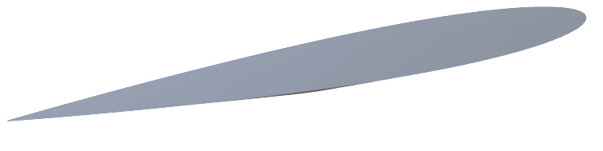
XFLR5 ANALYSIS
Graph Cm vs ⍺
[Un
stable]
-ve 8⁰ angle of

Slide 21

XFLR5 ANALYSIS
-ve 8 angle of incidence
⁰
Graph Cm vs ⍺
[
stable]

Slide 22
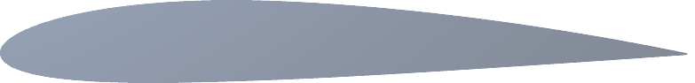

XFLR5 ANALYSIS
Airfoil Selection
High stability
Low drag
Symmetric
⁰
⁰⁰⁹
V tail
Reduced Interference Drag
Reduced weight than conventional tail configuration
Enhanced Maneuverability
Graph Cm vs ⍺
[
stable]
-ve 8 angle of incidence

Slide 23
XFLR5 ANALYSIS
Airfoil Selection
High stability
Low drag
Symmetric
⁰
⁰⁰⁹
V tail
Good stability
Enhanced lift
Delay drag rise
²⁴¹²

Slide 24


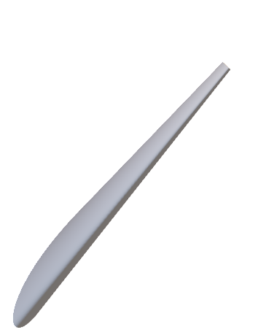
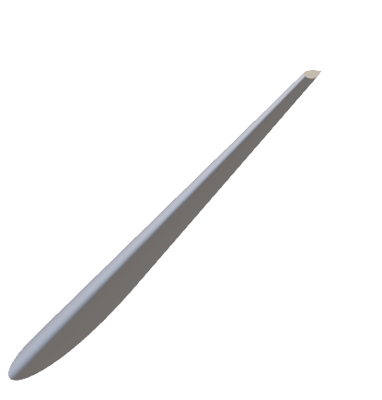
XFLR5 ANALYSIS
Configuration
Reduces adverse effects of transonic & supersonic flow
V tail
Reduced Interference Drag
Swept Wing
Increase Divergence Mach number
Reduced weight than conventional tail configuration
High maneuverability with low aspect ratio
Enhanced Maneuverability

Slide 25


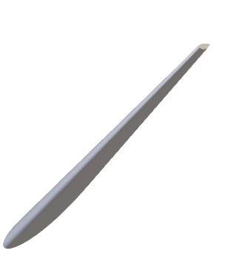

XFLR5 ANALYSIS
Configuration
Swept Wing
V tail
Reduces adverse effects of transonic & supersonic flow
Reduced Interference Drag
Increase Divergence Mach number
Reduced weight than conventional tail configuration
High maneuverability with low aspect ratio
Enhanced Maneuverability
Graph Cm vs ⍺
[
stable]
-ve 8 angle of incidence

Slide 26
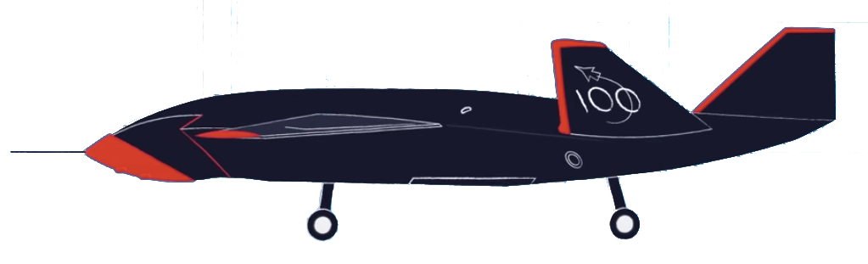

STABILITY TEST
High Altitude High Speed [Mode H]
Altitude – 44,000 ft (above MSL)
Speed – 171 knots (IAS)
Low Altitude Low Speed [Mode L]
Altitude – 16,000 ft (above MSL)
Speed – 155 knots (IAS)
*Images not to scale

Slide 27
STABILITY TEST
SPIRAL MODE
High Altitude High Speed [Mode H]
Altitude – 44,000 ft (above MSL)
Speed – 171 knots (IAS)
Low Altitude Low Speed [Mode L]
Altitude – 16,000 ft (above MSL)
Speed – 155 knots (IAS)
*Images not to scale

Slide 28
STABILITY TEST
Spiral Mode
High Altitude High Speed [Mode H]
Altitude – 44,000 ft (above MSL)
Speed – 171 knots (IAS)
Low Altitude Low Speed [Mode L]
Altitude – 16,000 ft (above MSL)
Speed – 155 knots (IAS)

Slide 29
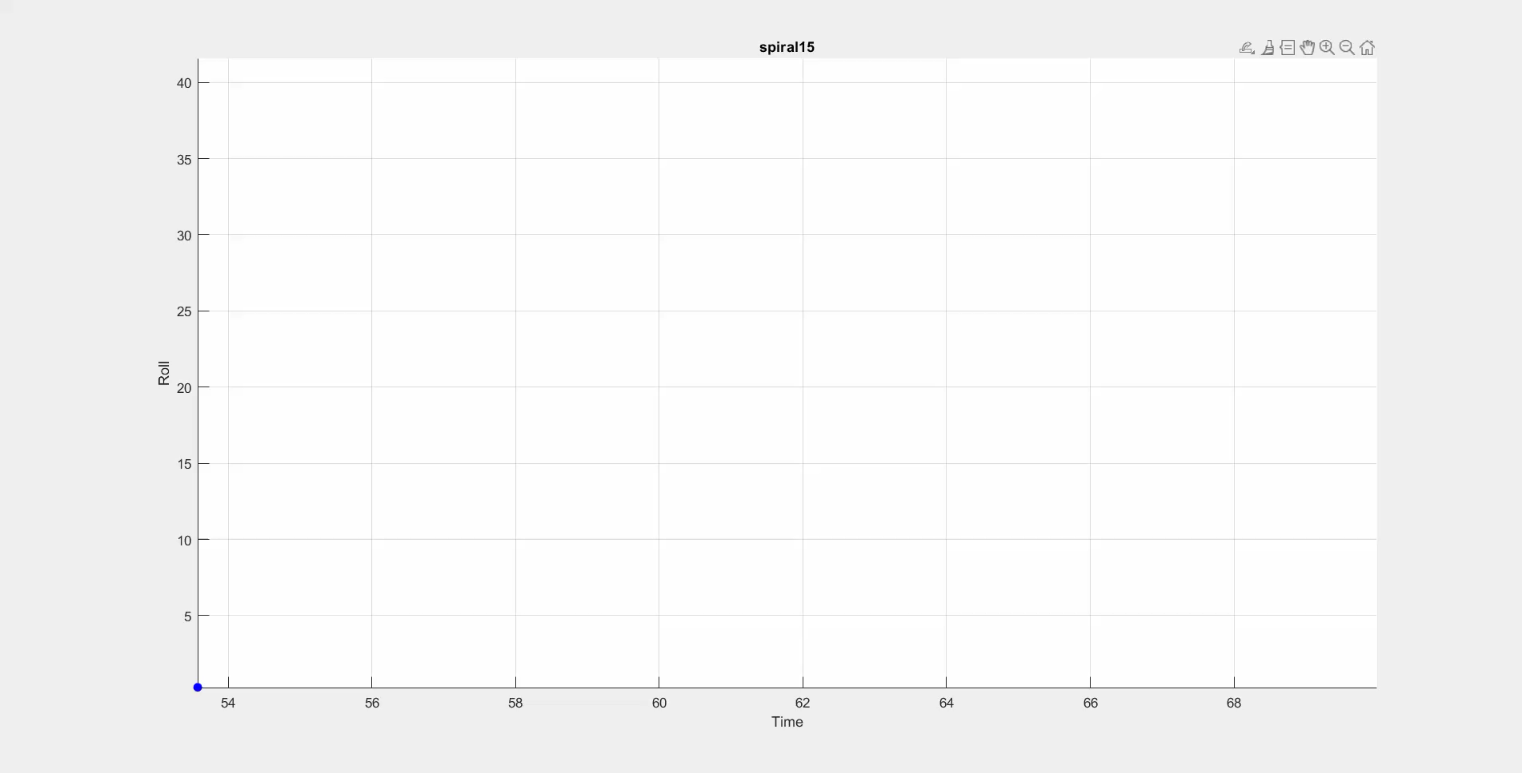
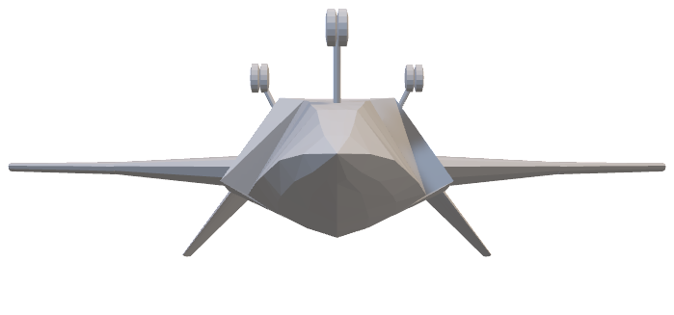
STABILITY TEST
Spiral Mode
High Altitude High Speed [Mode H]
Low Altitude Low Speed [Mode L]
15⁰

Slide 30
STABILITY TEST
Spiral Mode
High Altitude High Speed [Mode H]
Low Altitude Low Speed [Mode L]
15⁰

Slide 31
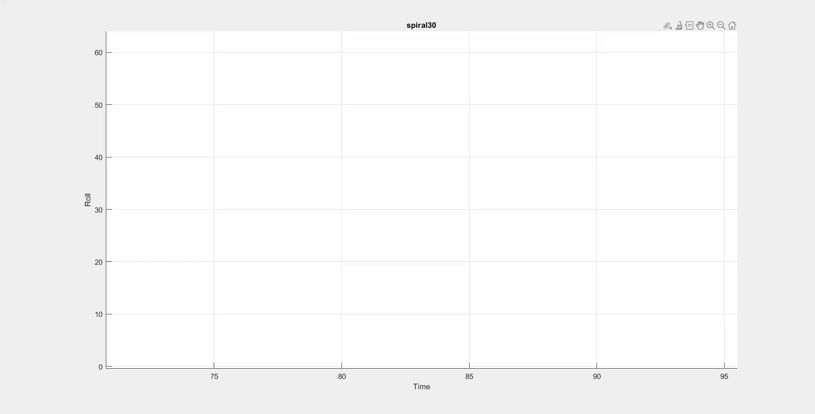
STABILITY TEST
Spiral Mode
High Altitude High Speed [Mode H]
Low Altitude Low Speed [Mode L]
30⁰

Slide 32
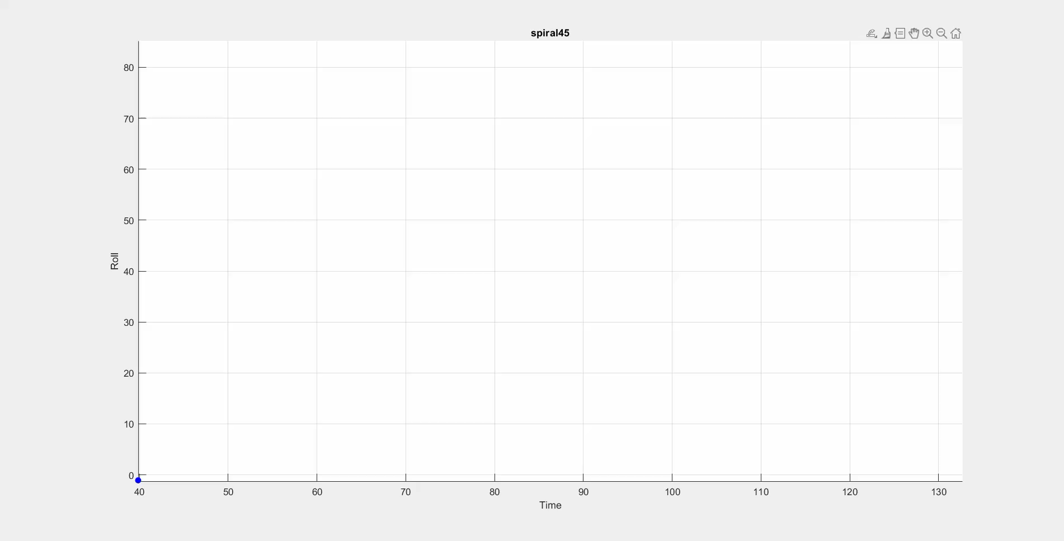
STABILITY TEST
Spiral Mode
High Altitude High Speed [Mode H]
Low Altitude Low Speed [Mode L]
45⁰

Slide 33
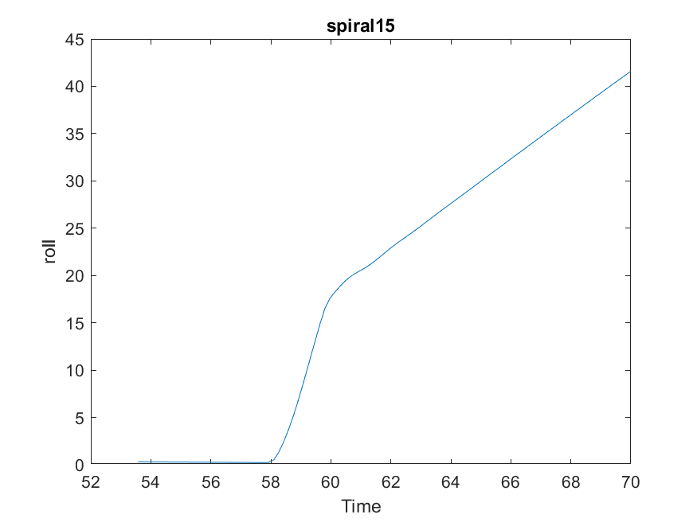
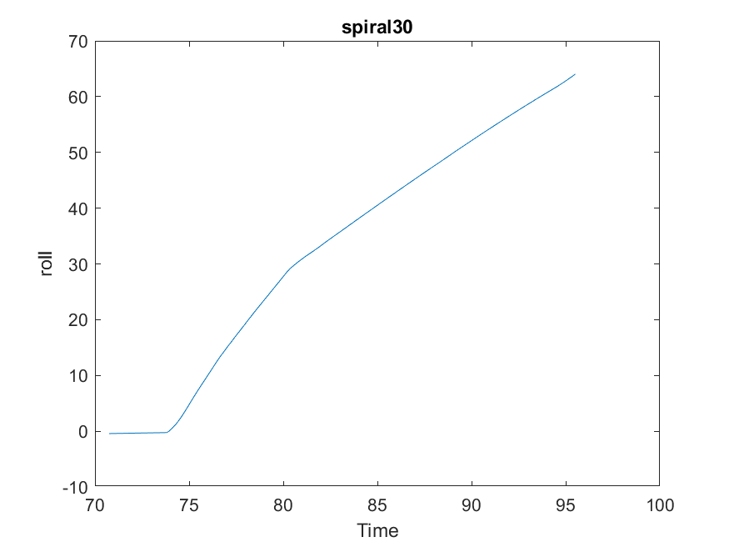
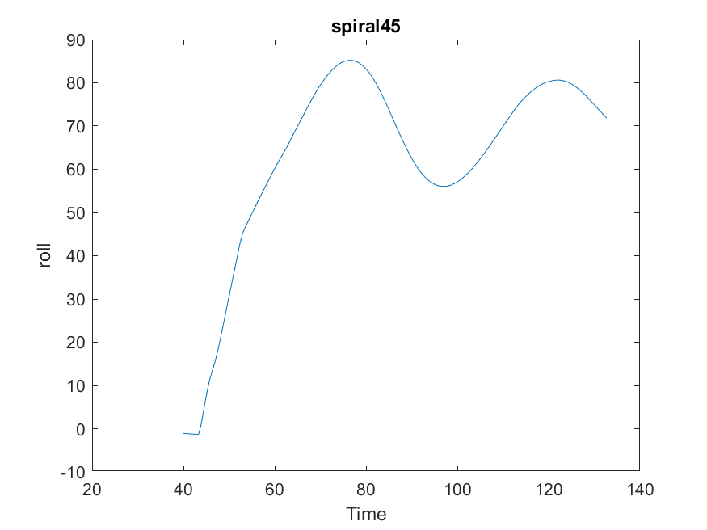
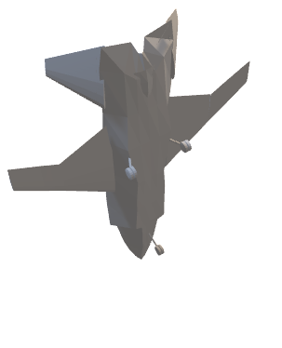
STABILITY TEST
Spiral Mode
High Altitude High Speed
[Mode H]
Low Altitude Low Speed
[Mode L]
15⁰
30⁰
45⁰

Slide 34
STABILITY TEST
Spiral Mode
High Altitude High Speed
[Mode H]
Low Altitude Low Speed
[Mode L]
15⁰
30⁰
45⁰
Graph Roll vs Time

Slide 35
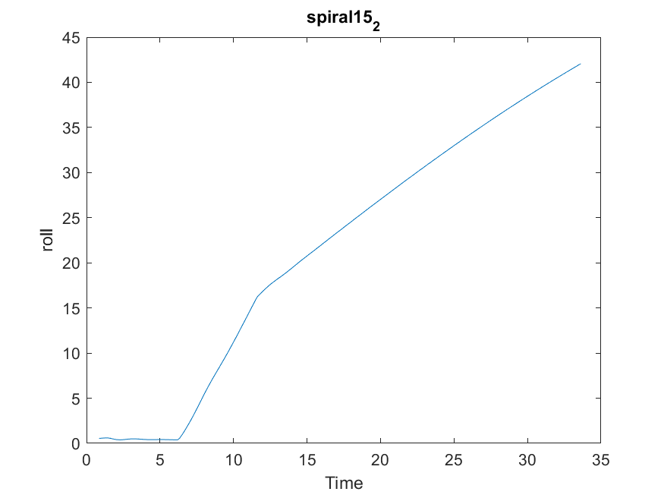
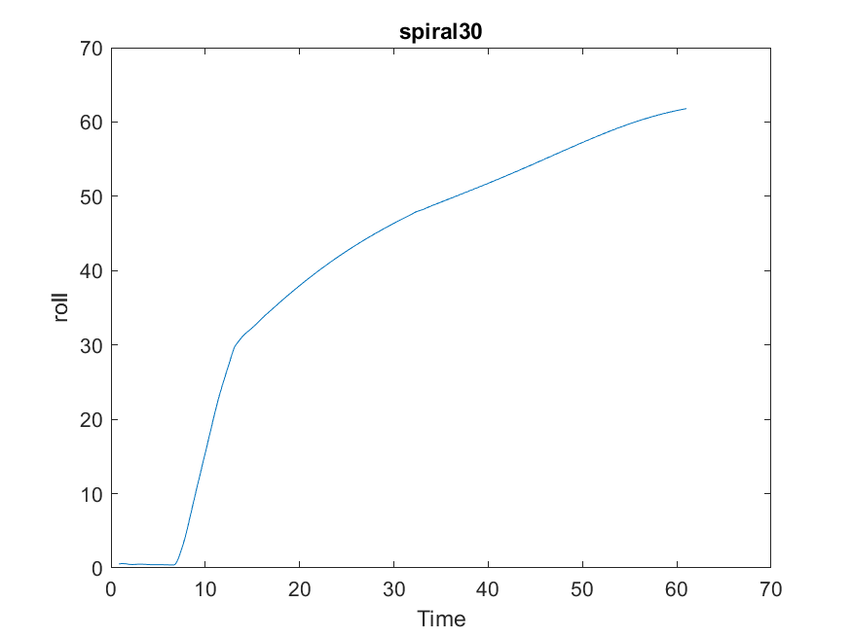
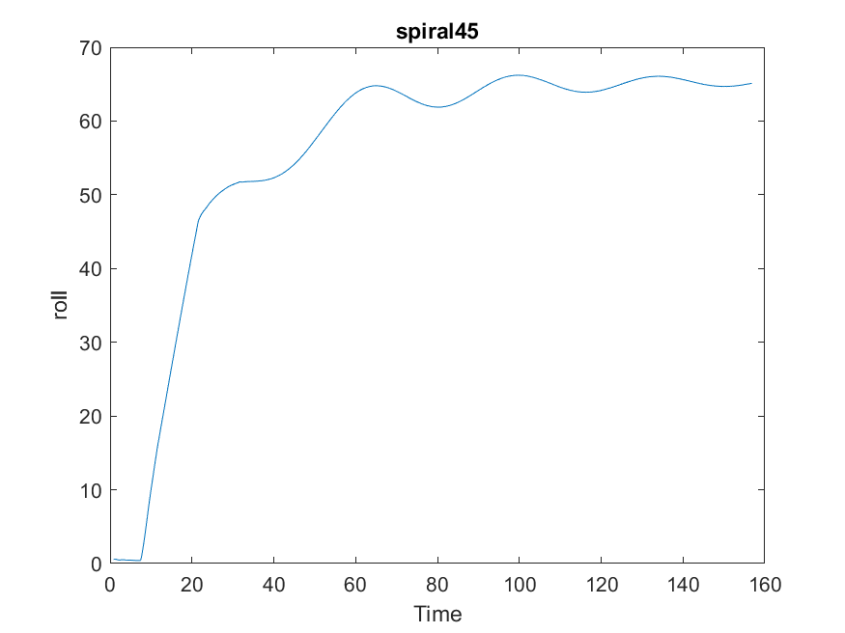
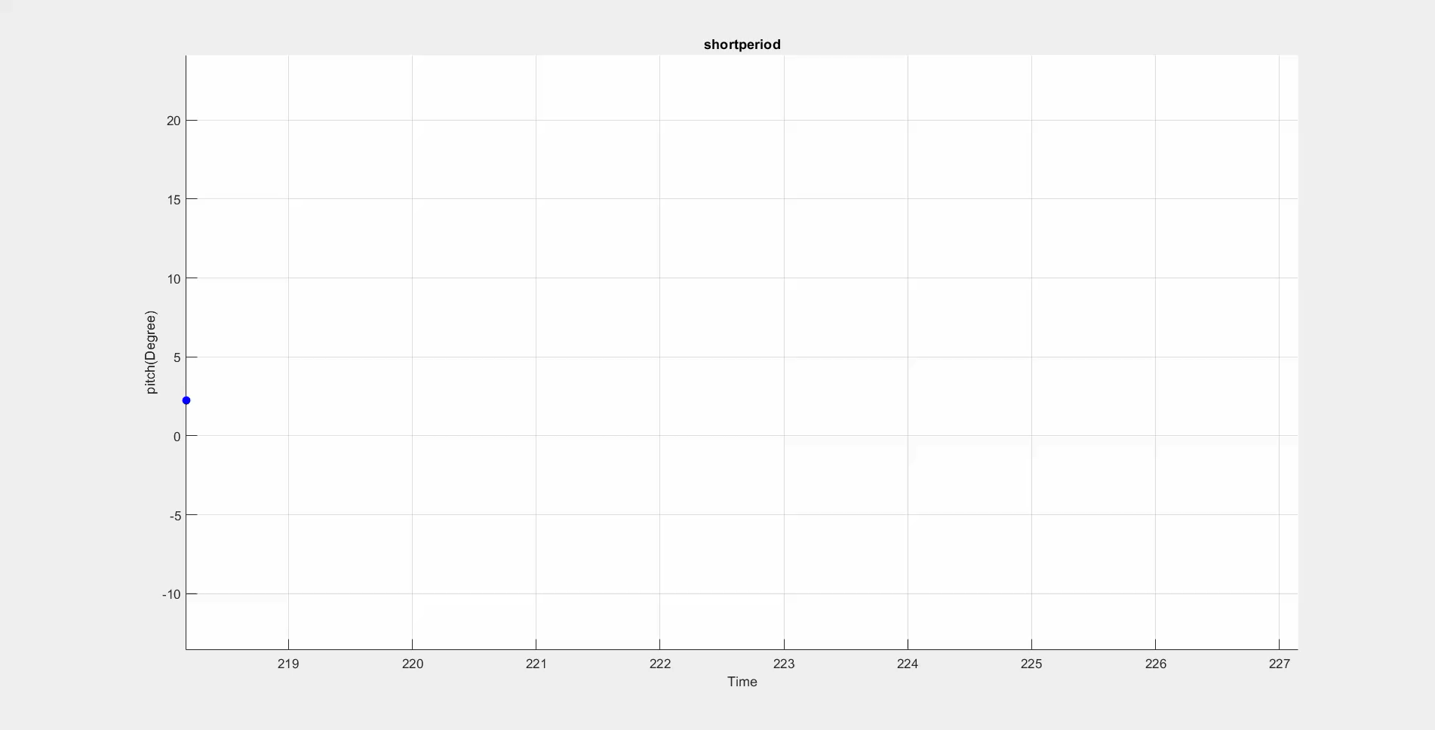
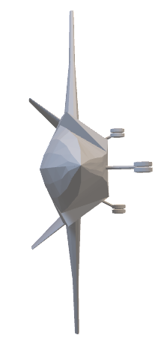
STABILITY TEST
Spiral Mode
[Mode H]
[Mode L]
15⁰
30⁰
45⁰
Graph Roll vs Time

Slide 36
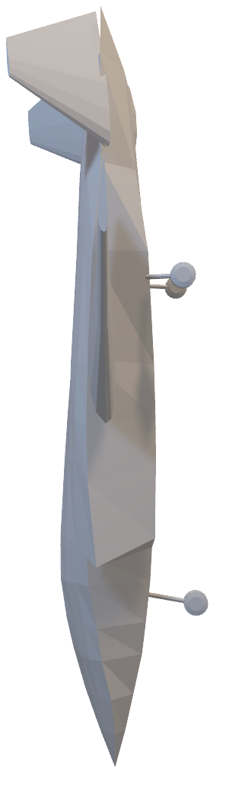
STABILITY TEST
Short Period Mode
High Altitude High Speed [Mode H]
High Altitude High Speed
[Mode H]
Low Altitude Low Speed
[Mode L]
Low Altitude Low Speed [Mode L]
15⁰
30⁰
45⁰
Pitch Doublet

Slide 37
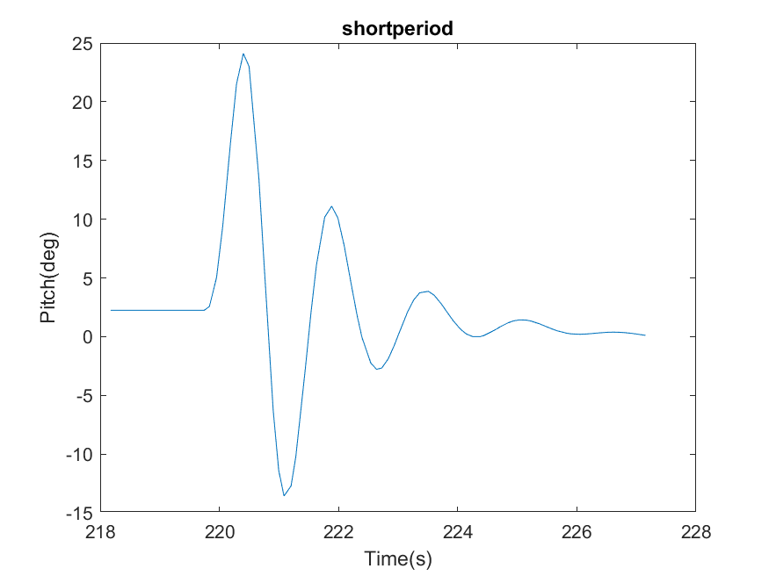
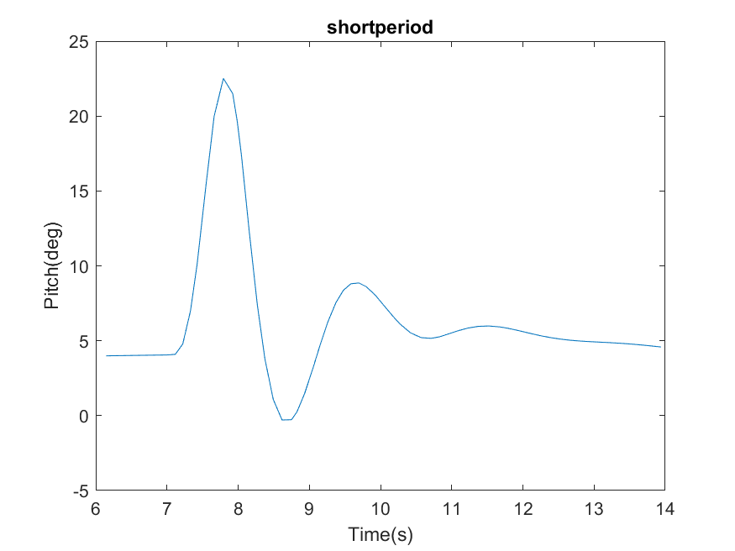
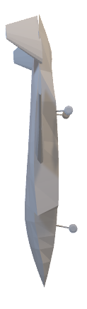
STABILITY TEST
Short Period Mode
High Altitude High Speed
[Mode H]
Low Altitude Low Speed
[Mode L]
Graph Pitch vs Time
Pitch Doublet

Slide 38
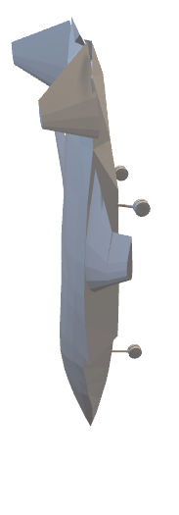
Low Altitude Low Speed
STABILITY TEST
Short Period Mode
High Altitude High Speed
[Mode H]
[Mode L]
Graph Pitch vs Time

Slide 39
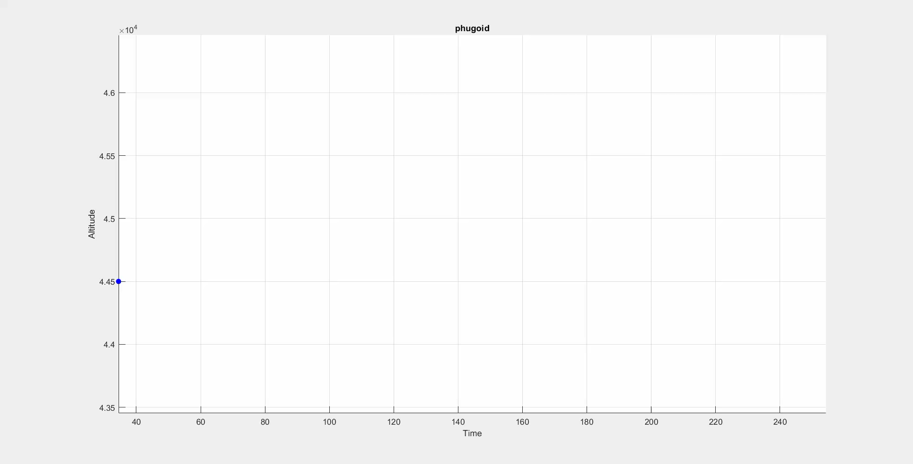
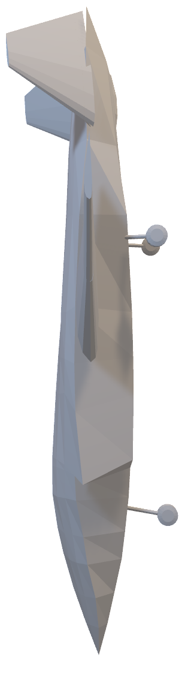
STABILITY TEST
Phugoid Mode
High Altitude High Speed [Mode H]
Low Altitude Low Speed [Mode L]
20⁰ Nose Up , decrease in velocity

Slide 40
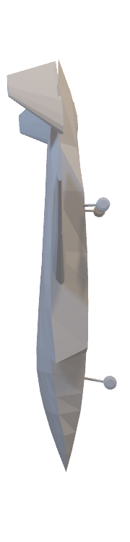
STABILITY TEST
Phugoid Mode
High Altitude High Speed [Mode H]
Low Altitude Low Speed [Mode L]
20⁰ Nose Up , 10% decrease in velocity

Slide 41
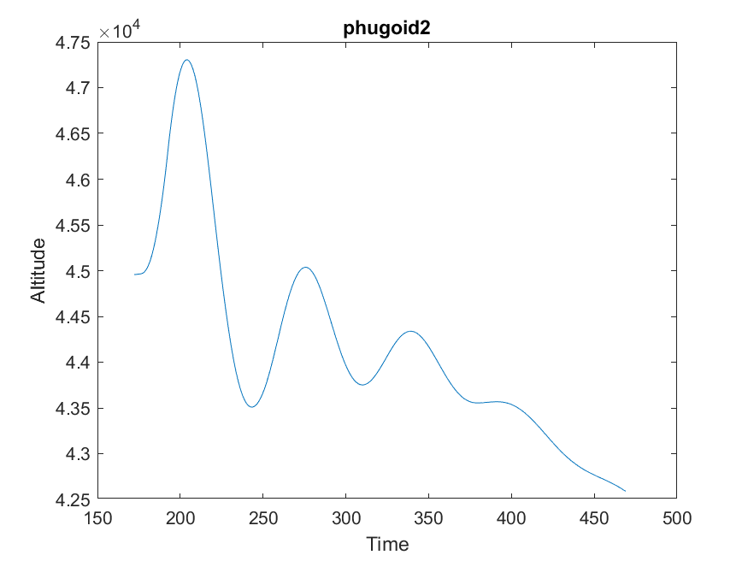
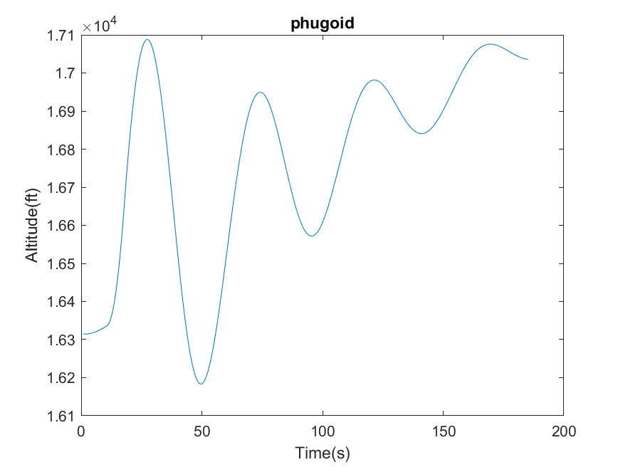
STABILITY TEST
Phugoid Mode
High Altitude High Speed
[Mode H]
Low Altitude Low Speed
[Mode L]
20⁰ Nose Up , 10% decrease in velocity
Graph Altitude vs Time

Slide 42
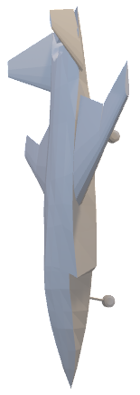
Low Altitude Low Speed
STABILITY TEST
Phugoid Mode
High Altitude High Speed
[Mode H]
[Mode L]
Graph Altitude vs Time

Slide 43
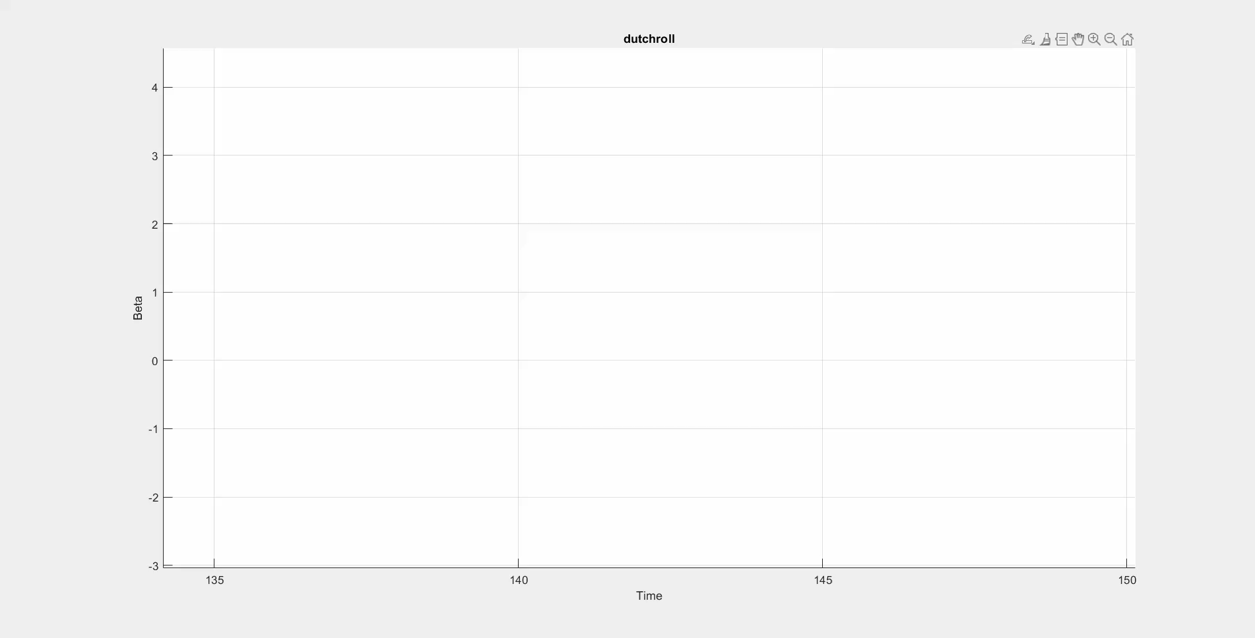
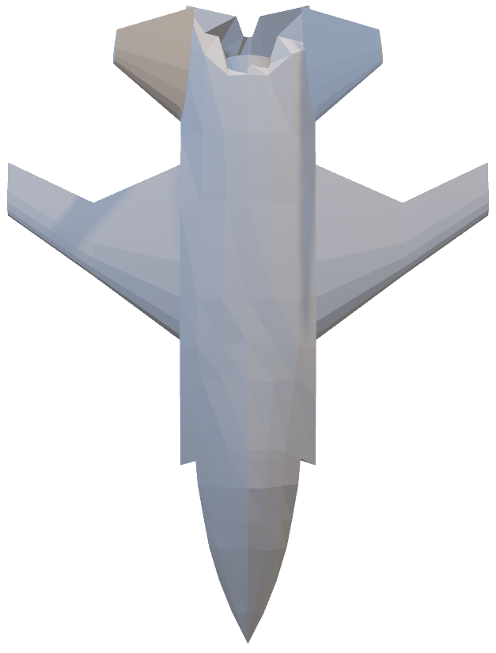
STABILITY TEST
Dutch Roll
High Altitude High Speed [Mode H]
Low Altitude Low Speed [Mode L]
Rudder Doublet

Slide 44
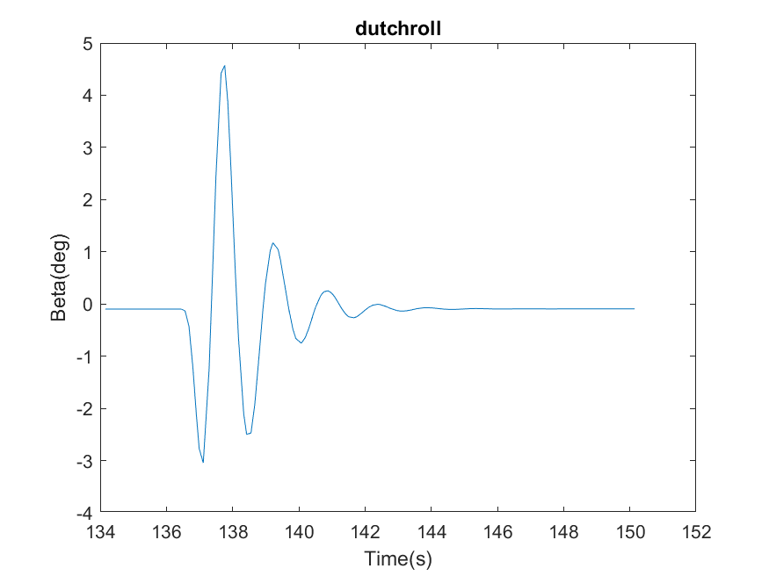
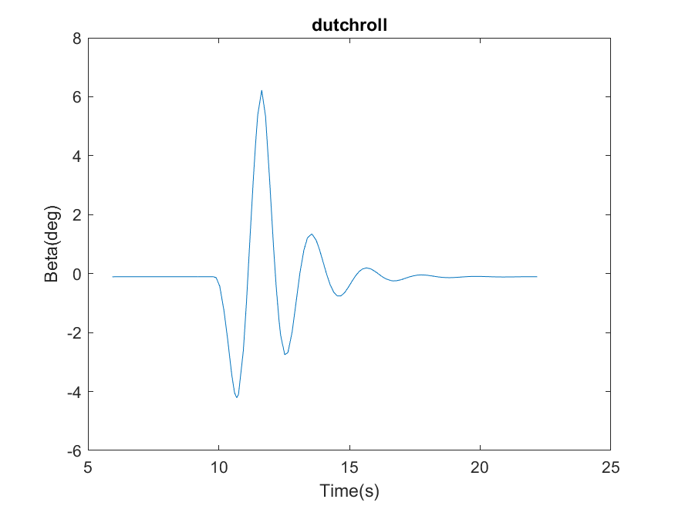
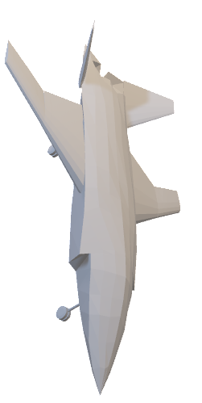
STABILITY TEST
Dutch Roll
High Altitude High Speed
[Mode H]
Low Altitude Low Speed
[Mode L]
Rudder Doublet
Graph β vs Time

Slide 45
Low Altitude Low Speed
STABILITY TEST
Dutch Roll
High Altitude High Speed
[Mode H]
[Mode L]
Graph β vs Time

